Slide 1
Assessment Information Evening
March 2015

Slide 2
Curriculum 2014 – why?
26th in the International PISA tests
Primary not adequately preparing for Secondary

Slide 3
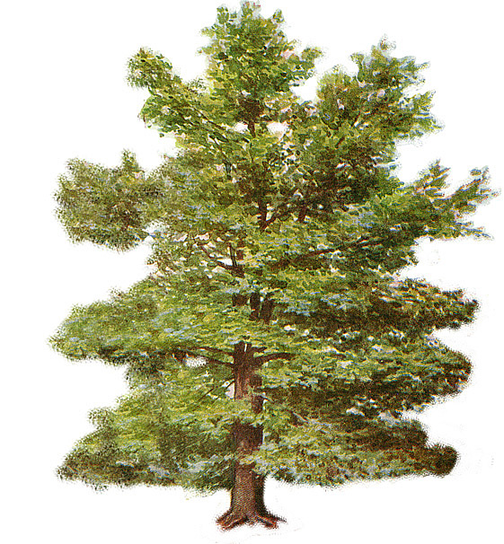
Assessing without Levels – why?
Over complicated
Too focused on moving upwards – not enough depth or ‘mastery’
Not challenging enough
Low attainment hidden behind ‘progress’

Slide 4
Assessing without Levels – how?
External testing:
Baseline on entry to Reception
Year One Phonics Screening
Year Two & Six tests in:
Reading,
Grammar, Punctuation and Spelling
Mathematics
Writing tested in Year Two, teacher assessed in Year Six
Science sampling at Year Six, teacher assessed at Year Two

Slide 5
Assessing without Levels – how?
Internal testing and assessment:
Termly tests in:
Reading
Grammar, Punctuation and Spelling
Mathematics
Writing
Teacher assessment for all other subjects

Slide 6
How will this be measured and reported?
Each school to develop own systems
Moderation between schools for consistency
‘At’, ‘above’, ‘below’ end of year expectations

Slide 7
Twiss Green’s system:
below | below | working towards | working towards | at | at | mastering | mastering | exceptional
1 | 2 | 3 | 4 | 5 | 6 | 7 | 8 | 9
<25% | 25-50% | 50-75% | 75-100% | 100% | 100 + 25% | 100 + 50% | 100 + 75% | exceptional

Slide 8
Tracking pupils:
By Christmas:
below | below | working towards | working towards | at | at | mastering | mastering | exceptional
1 | 2 | 3 | 4 | 5 | 6 | 7 | 8 | 9
<25% | 25-50% | 50-75% | 75-100% | 100% | 100 + 25% | 100 + 50% | 100 + 75% | exceptional
Child A | Child B | Child C | Child D

Slide 9
Tracking pupils:
By Easter:
below | below | working towards | working towards | at | at | mastering | mastering | exceptional
1 | 2 | 3 | 4 | 5 | 6 | 7 | 8 | 9
<25% | 25-50% | 50-75% | 75-100% | 100% | 100 + 25% | 100 + 50% | 100 + 75% | exceptional
 | Child A | Child B | Child C |  | Child D

Slide 10
Tracking pupils:
By End of Year:
below | below | working towards | working towards | at | at | mastering | mastering | exceptional
1 | 2 | 3 | 4 | 5 | 6 | 7 | 8 | 9
<25% | 25-50% | 50-75% | 75-100% | 100% | 100 + 25% | 100 + 50% | 100 + 75% | exceptional
 |  | Child A |  | Child B | Child C | Child D

Slide 11
Have we addressed the issues?
below | below | working towards | working towards | at | at | mastering | mastering | exceptional
1 | 2 | 3 | 4 | 5 | 6 | 7 | 8 | 9
<25% | 25-50% | 50-75% | 75-100% | 100% | 100 + 25% | 100 + 50% | 100 + 75% | exceptional
Over complicated
Too focused on moving up – not enough depth
Low attainment hidden behind ‘progress’

Slide 12
What does this mean for your child?
More challenging level of understanding in each year
Old curriculum | New curriculum
below | significantly below
at | below
above | at
Significantly above | above

Slide 13
Tim Oates explains ‘Assessment without Levels’

Slide 14
Questions?

Slide 15
Year Two and Six SATs 2015

