Slide 1
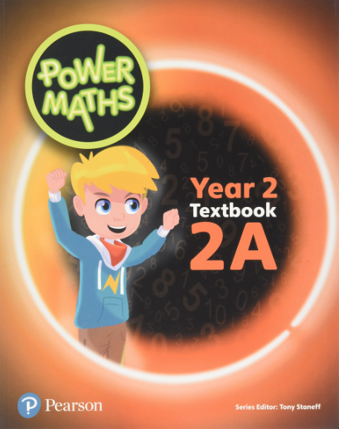
Teaching for
Mastery in
Maths

Slide 2
The 2014 National Curriculum for mathematics has been designed to raise standards in mathematics, with the aim that the large majority of pupils will achieve mastery of the subject.

Slide 3
New National Curriculum 2014
New Curriculum and Ofsted framework were introduced in 2014, and we wanted to provide the children with a ‘Mastery’ curriculum.
The new curriculum places a high importance on mental maths skills and fluency of these.
The new curriculum also places a high importance on reasoning and problem solving skills.
‘Mastery’ means doing fewer things in greater depth to ensure skills are learned. The new National Curriculum is a Mastery curriculum

Slide 4
Year 2: Show that addition of two numbers can be done in any order (commutative) and subtraction of one number from another cannot

Slide 5
Year 3: add and subtract numbers with up to three digits, using formal written methods of columnar addition and subtraction

Slide 6
Year 5: Measure and calculate the perimeter of composite rectilinear shapes in centimetres and metres

Slide 7
Teaching for Mastery at TG
Gradual introduction of teaching for Mastery in Maths started in 2014 and continues to date.
Main difference in teaching is that all children in a class are expected to be taught the same objectives.
Children who need extra help to ‘keep up’ are given immediate intervention.
Children who are quick at developing skills are given more demanding problem solving and reasoning questions.

Slide 8
TG Calculation policies
Many resources have been developed and used, the White Rose Maths resources produced by the West Yorkshire Maths Hub being very effective.
January 2017 (updated June 2018) we developed a new Twiss Green Calculation and Mental Calculation policy in line with Mastery teaching. (On the website)

Slide 9
Power Maths
The focus of the scheme is on teaching to mastery (complete understanding), by allowing enough time on a topic for a child to comprehend it thoroughly before moving on.
The programme emphasises problem-solving and pupils using their core skills to develop a relational understanding of mathematical concepts. It uses 3 key stages.

Slide 10
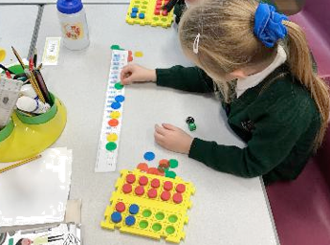
CPA Approach
Concrete representation
The active stage - a child is first introduced to an idea or a skill by acting it out with real objects. ‘Hands on‘

Slide 11
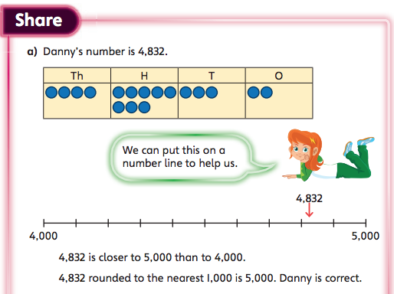
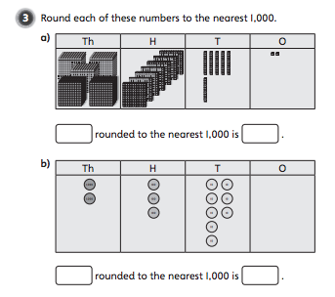
Pictorial representation
The child can now relate the ‘hands on’ to representations, such as a diagram, picture of the problem or a bar model.

Slide 12
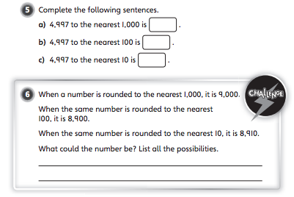
Abstract representation
The symbolic stage - a child is now capable of representing problems by using mathematical notation. E.g 6+4=10

Slide 13
In Summary
All classes will receive a practical and well-pitched curriculum.
Teaching will be consistent across the school.
We will continue to develop our Maths teaching through involvement with the local Maths Hub.
Our children will become successful mathematical thinkers who enjoy the challenge of mathematical activities.

